Slide 1

ECON251 Industry and Trade in Asia
Challenges and future of Asia

Slide 2
Lesson Objectives
At the end of the lesson students should be able to
Explain the development issues such as poverty , income distribution, aging population, environmental degradation in Asia
Explain how the development issues may affect the economic growth of Asia economies

Slide 3

The journey thus far
World Bank : Stronger Open Trade Policies Enable Economic Growth for All
https://youtu.be/Ap-M30CRGtI

Slide 4
Challenges
Key challenges
Income Inequality
Environment and climate change
Future
Aging population
Asia Divide vs Collaboration

Slide 5
Current Challenges
With the past discussions of Asia’s growth, though hampered by the two major crisis, these economies are still in the radar of international attention on their considerably stellar economic performance
We now like to consider the economic development of these economies
Development
Quality of life
Standard of living
Growth
Rising spending
Rising income
Rising production
Introduction

Slide 6
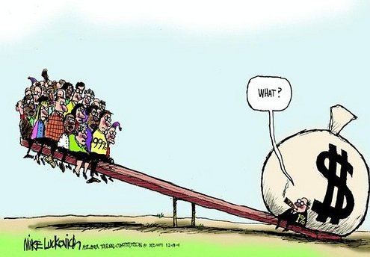
Current Challenges
Income Inequality

Slide 7
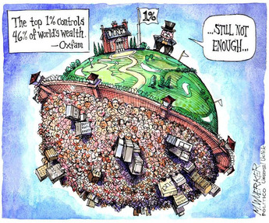
Income Inequality
A case of wealth not fairly distributed amongst the people in the country
This phenomenon is not new but did globalisation worsen it, esp in Asia ?
Video Link
https://youtu.be/BtVNO0H7yLU?si=Ct1ZgJQQci5GkHdc

Slide 8
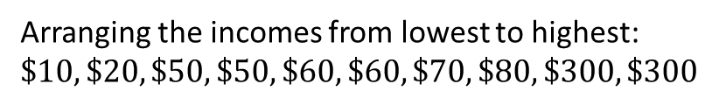
2. Income Inequality
Imagine an island with 10 persons with total GDP of $1000; GDP per capita = 1000/10 = $ 100
But the true fact is :
if 20% of the population (i.e. 2 persons) own 60% of the income (i.e. $600), each of them in average gets $300
Then the remaining population i.e. 8 persons share out the $400 , each getting $50 or lesser
What exactly is it ?
Arranging the incomes from lowest to highest:
$$\$10,\$20,\$50,\$50,\$60,\$60,\$70,\$80,\$300,\$300$$
20% of population holds 60% of wealth

Slide 9
2. Income Inequality – Measurement
Or
GINI INDEX
Gini coefficient is a widely used measure of inequality and takes into account income distribution among residents of a country.
Range between 0 to 100 where the value of 0 suggest no income inequality and 100 suggest perfect income inequality
The higher the Gini coefficient, the greater is the inequality.

Slide 10
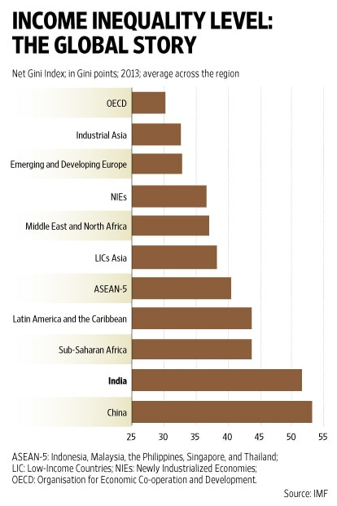
The global trend
Common myth

Slide 11
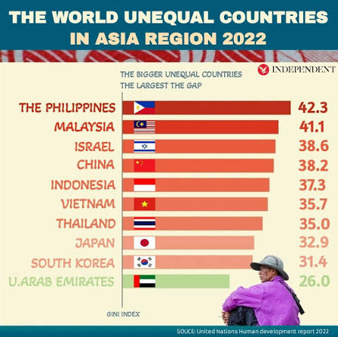
Income inequality in Asia

Slide 12
The common myths and sayings
Occurs in mainly large populous countries [ Indonesia, India, China]
Occurs where the countries has a significant urban – rural divide
Rich countries problems
Its inevitable

Slide 13
Why it occurs & why it is hard to measure
Trade and production
FDI gains by enterprise , repatriated back
Smaller rise in wages to the lowly skilled workers
FDI
Inflow of capital into assets market boost stock market and property market
Inflation and higher cost of living
Infrastructure, education level improves , govt collect more taxes to help the displaced
Slow down trade and industrialisation ?

Slide 14

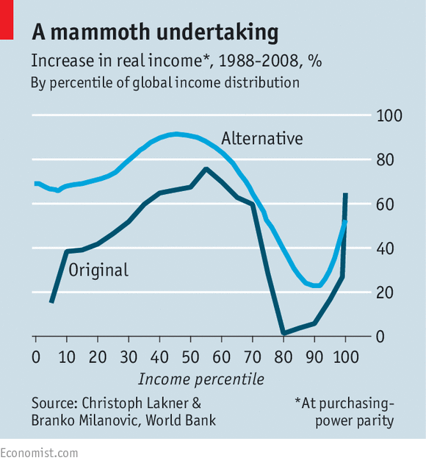
Growth-focused economies often ignore the poverty and income inequality on the expectation that income will trickle down.
Tackle income inequality “Move more to middle class income “
Middle income
(https://www.edb.gov.sg/en/news-and-events/insights/innovation/understanding-southeast-asias-middle-class.html)

Slide 15
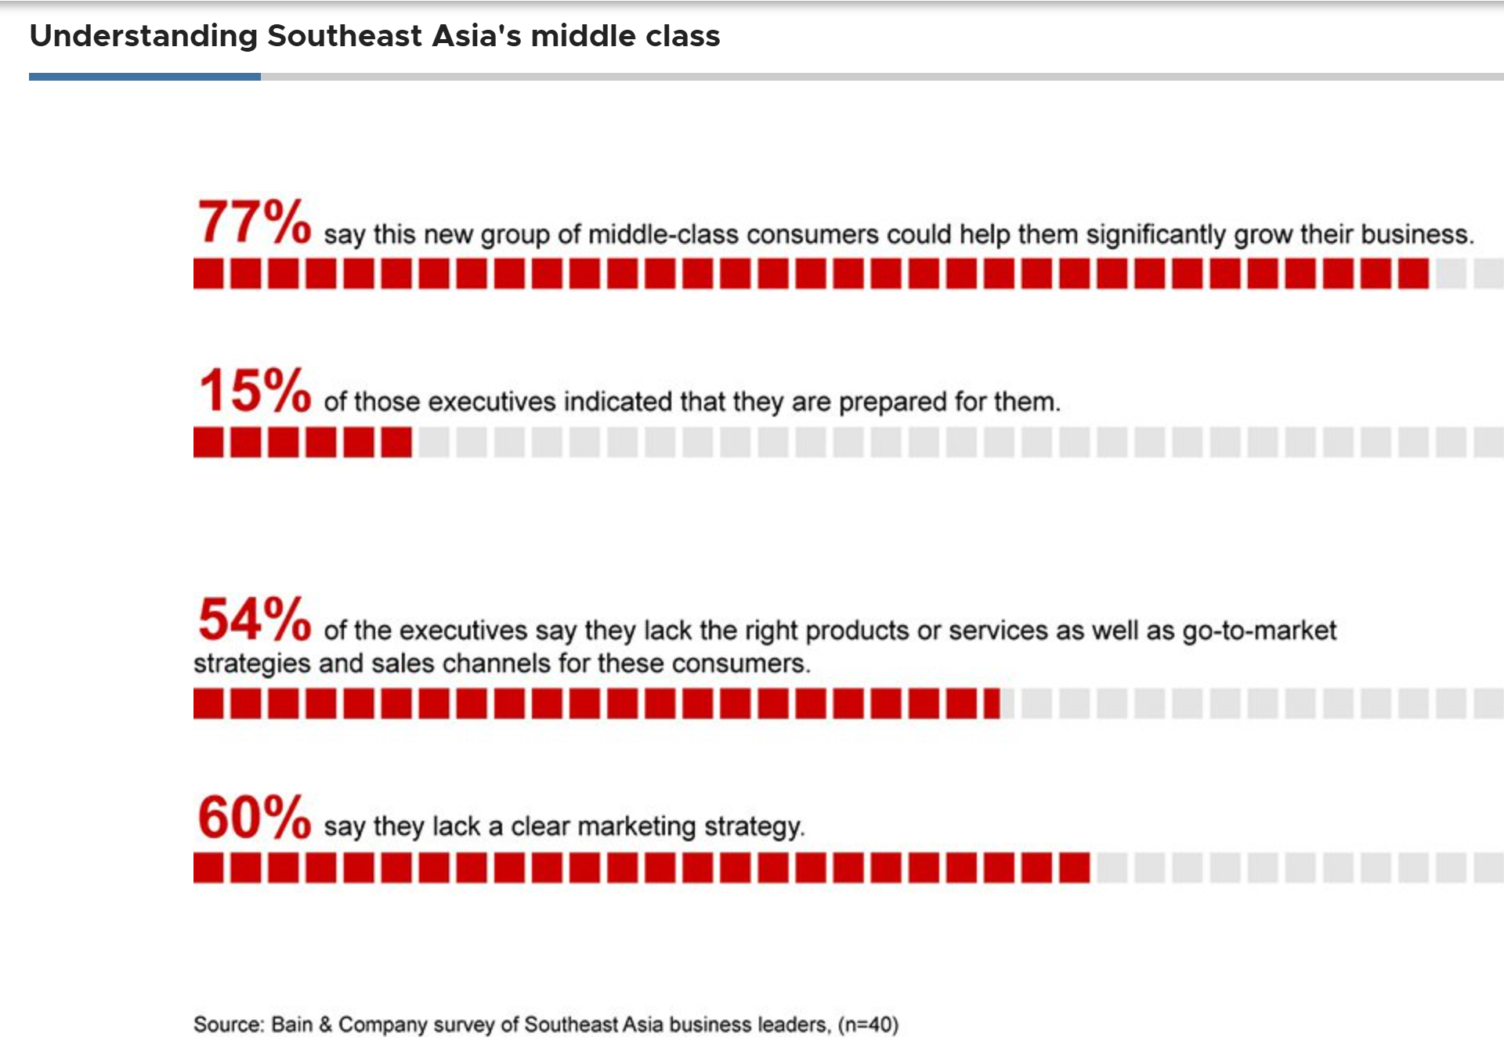
Why it matters
Esp. for the populous Asia economies
The poor and the middle class can be the driving force for growth via interrelated economic, social and political channels.
(https://www.edb.gov.sg/en/news-and-events/insights/innovation/understanding-southeast-asias-middle-class.html)

Slide 16
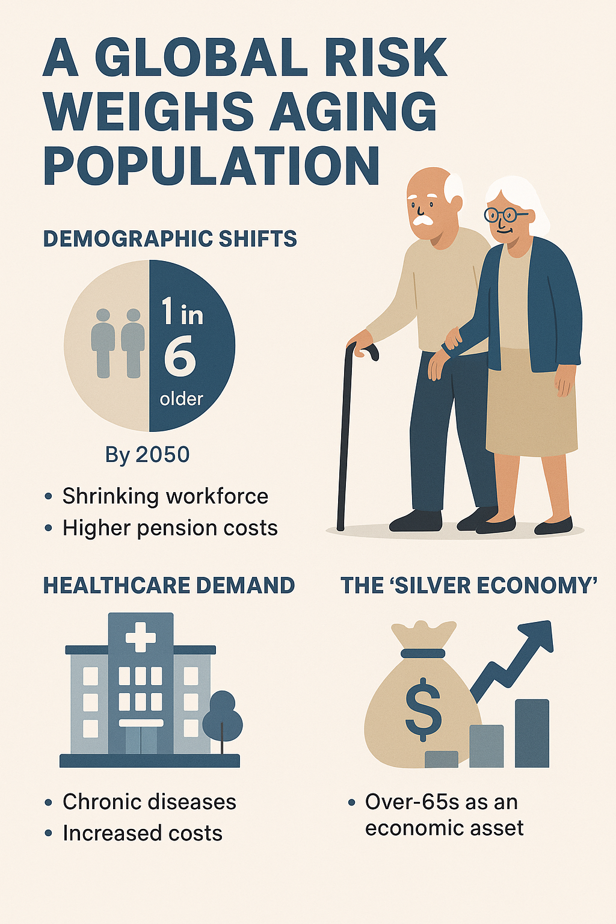
Current Challenges
2. Aging Population

Slide 17
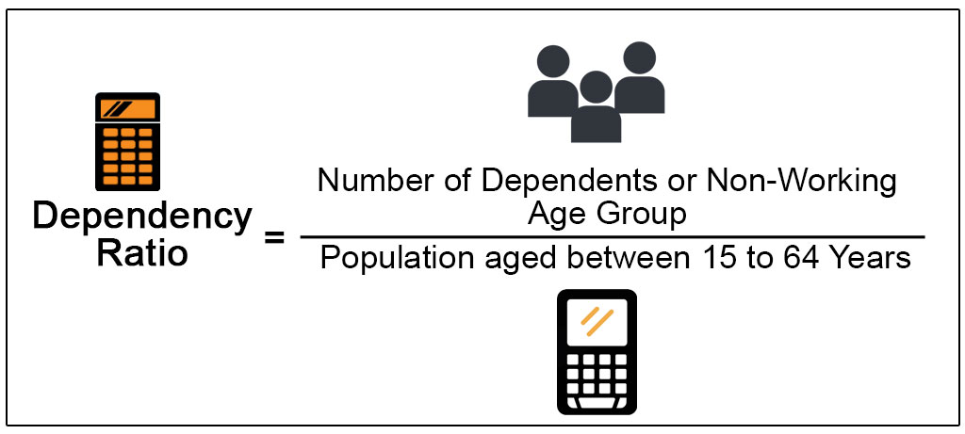
Dependency ratio
Ie the labour force
Effects of aging population and declining birth rates : Dependency ratio rises

Slide 18
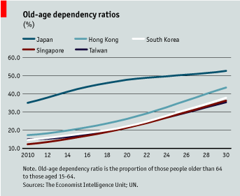
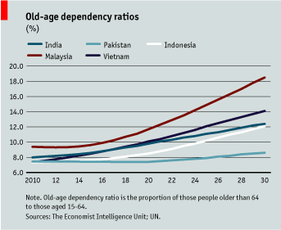

Slide 19
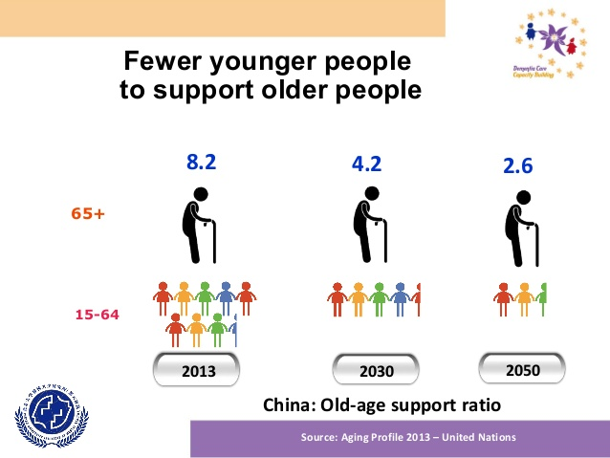

Slide 20
Aging population and dependency ratio and economic implications
.
Aging population
Falling birth rates
Rising DEPENDENCY
RATIO
Labour shortages
Younger generation pay higher taxes
Work longer hours
Greater govt spending on healthcare and infrastructure for elderly
Lower tax collection

Slide 21
Lower Dependency Ratio
Effects of increasing retirement age ?
Increase the labour force : Asean collaboration
Use of AI

Slide 22
***Current Challenges ***
Energy and Environment
Video Links
https://youtu.be/EkFJF_nI2MQ

Slide 23
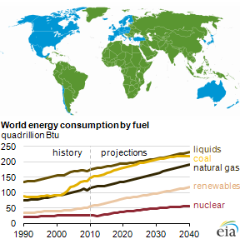
Economic growth and energy consumption
Trade
Industrialisation
Factory output & GDP

Slide 24
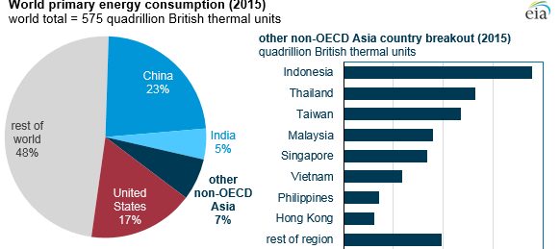
Industrialization
Urbanization
Rising demand for energy

Slide 25
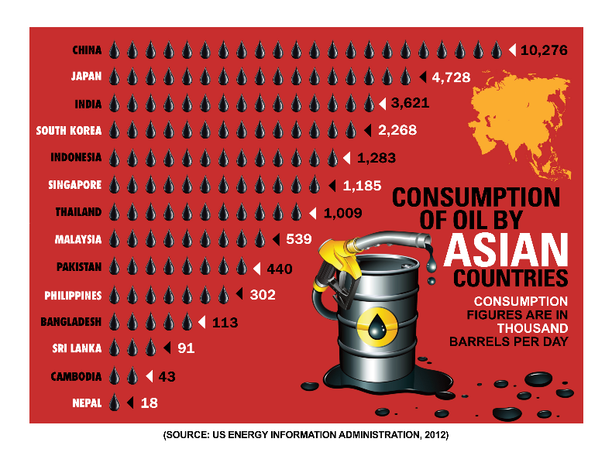

Slide 26
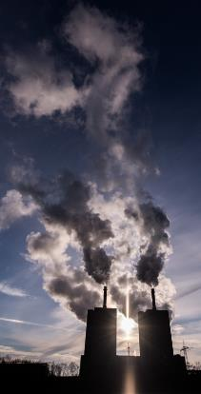
Environmental degradation
In 2010, China emitted around 8.3 billion tons of CO₂.
more than the combined total of Brazil (0.4 billion), France (0.3 billion), Germany (0.7 billion), United Kingdom (0.5 billion) and the US (5.4 billion).
India and Japan together emit 3.1 billion tons annually (ADB, 2014).
This was more than Germany’s emissions in 2010 (0.7 billion).
Thus, Asia is a major contributor of CO₂ emissions in absolute terms (ADB, 2014).

Slide 27
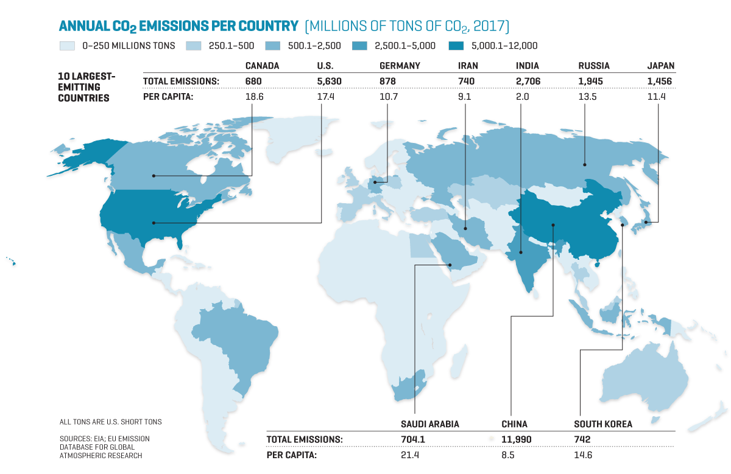

Slide 28
Climate change How and Who will be affected
Floods and storms
Forest fire
Drought
Video Links
https://youtu.be/EkFJF_nI2MQ
Industrialization
Pollution
Rising temperature
Rising sea level
CLIMATE CHANGE

Slide 29
Source: http://accept.aseanenergy.org

Slide 30
Cost of climate Change
*** Climate Change
The cost has been increasing, particularly for South, East and Southeast Asia.
Cost of climate Change : https://youtu.be/5nGYkH9ifzM [ From 4:50 to
Loss of GDP but also a financial crisis ?
Video Link
https://www.facebook.com/McKinsey/videos/future-of-asia-climate-change/2660511377525150/

Slide 31
Climate change – Economic costs
Food Security
Agriculture sector is most vulnerable to climate risk
Disruption in crop yields
Quality of crops

Slide 32
Economic Cost of climate costs
Infrastructure
Threats and impacts of flooding
Loss of value of assets
Disruption to communication system via optic fiber network
Flow of FDI

Slide 33
Climate change Why it matters?
Market Distortions
Production disruption & Supply chain disruptions increase operational costs
Prices distorted due to govt policy to mitigate climate change : Carbon tax [See video link https://youtu.be/EbF4s2LF_kg]
Govt rechanneling of resources to tackle climate change

Slide 34
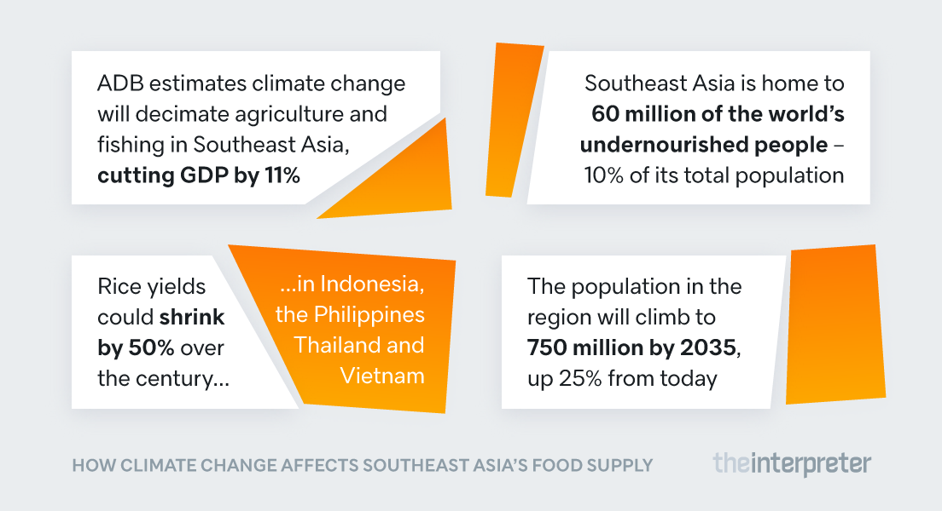

Slide 35
Climate change The role of Asia
https://youtu.be/EkFJF_nI2MQ?si=i96MT7NN--7l4bW9

Slide 36
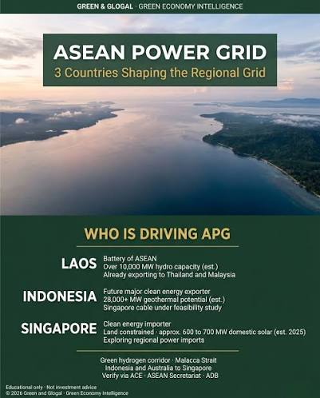
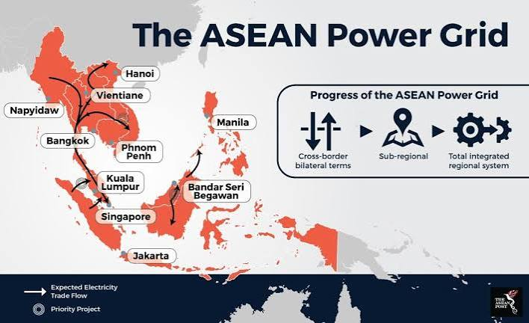
Asia Collaboration :
cross-border flows of renewable energy

Slide 37
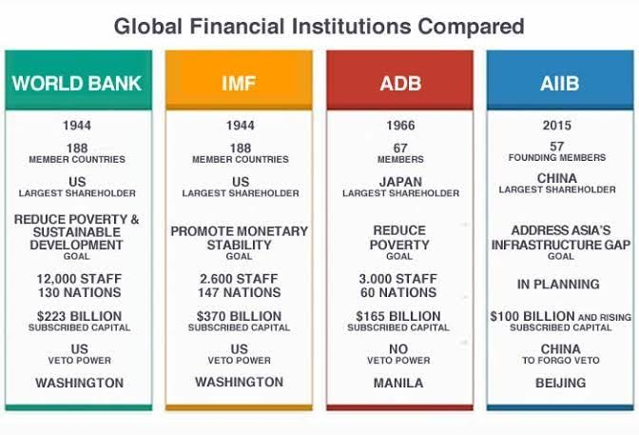
Asian Development Bank (ADB)
Asian Infrastructure Investment Bank (AIIB)

Slide 38
The Future of Asia
Collaborate or Compete

Slide 39

Changing Trade Patterns Video link

Slide 40
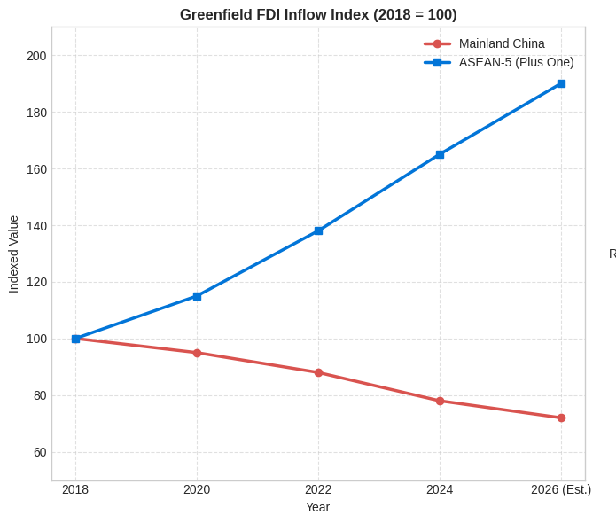






Changing Trade Patterns
The tides changed
The "China +1" Strategy
RCEP Integration
Decentralized Value Networks
Corporations are diversifying away from single-source manufacturing in China, redirecting investments to ASEAN (Vietnam, Indonesia, Malaysia) to mitigate geopolitical risk.
The Regional Comprehensive Economic Partnership streamlines rules of origin across 15 nations, cutting transaction friction and anchoring pan-Asian supply chains.
Trade evolution shifts from linear final assembly lines to complex regional value chains (RVCs) scaling intermediate goods exchange throughout Southeast Asia.

Slide 41







Changing Trade Patterns
The Geopolitical Race for Minerals and Energy
Critical Minerals Hub
Energy Security
Resource Nationalism
ASEAN economies (especially Indonesia with nickel) hold vital raw materials essential for electric vehicle (EV) batteries and high-tech electronic components.
Accelerating industrialization and AI-driven data centers demand massive power scaling, forcing nations to secure reliable, green, and transitional energy grids.
Export bans on raw ores and industrial policies aim to force domestic refining, turning mineral wealth into higher-value national manufacturing leverage.

Slide 42
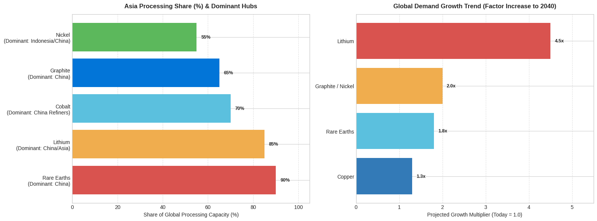
Source: International Energy Agency (IEA) – Global Critical Minerals Outlook reports and related energy-security tracking data

Slide 43
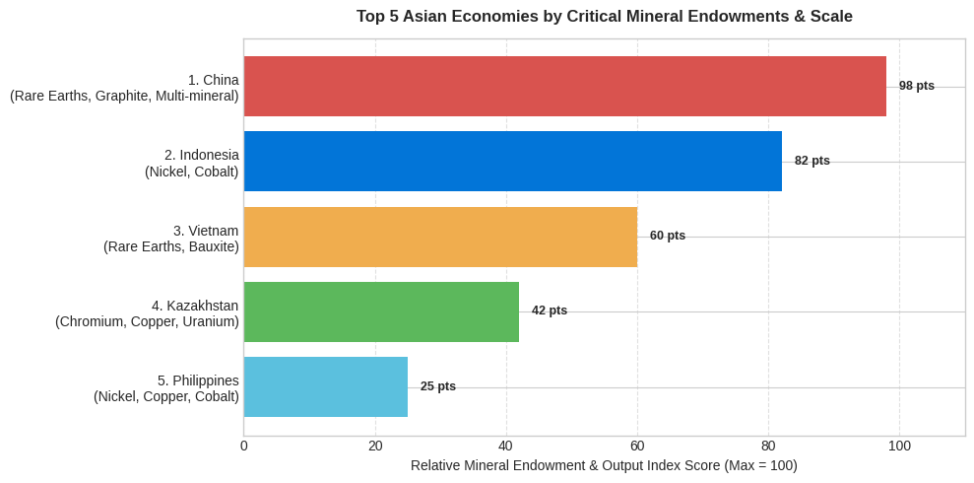

Slide 44

This Photo by Unknown Author is licensed under CC BY-NC-ND

